Slide 1
Import / Export Board Configuration
ALM Rangers
Jesse Houwing, Tiago Pascoal, Kees Verhaar, Chris Mason, Gregory Ott, Igor Macedo, Michael Krief, Prasanna Ramkumar PM Edward Fry, PO Sondra Batbold

Slide 2
Another team is using a great board layout and I want to quickly replicate that to my team

Slide 3
WE’VE CREATED A STANDARD LAYOUT WE WANT TO APPLY ACROSS MULTIPLE TEAMS

Slide 4
Proposal
First version
MVP
Basic UI
Solve most user needs.
Following versions
Grow incrementaly to support more complex scenarios
Import/export to other team projects

Slide 5
As a team administrator I want to have the same settings as another team

Slide 6
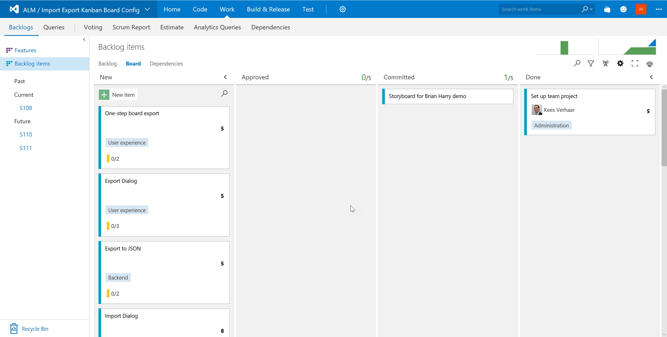
Importing and exporting your board configuration!
You’ve installed the Import Export Board Configuration extension, it allows you to apply the configuration of your board to another team, or grab the configuration of another team and apply it to your board.
To use this extension you must be the Team Administrator or a Project Administrator.

Slide 7
Apply to other team(s)
Apply from other team
Either opens a menu or launches directly into a wizard.

Slide 8
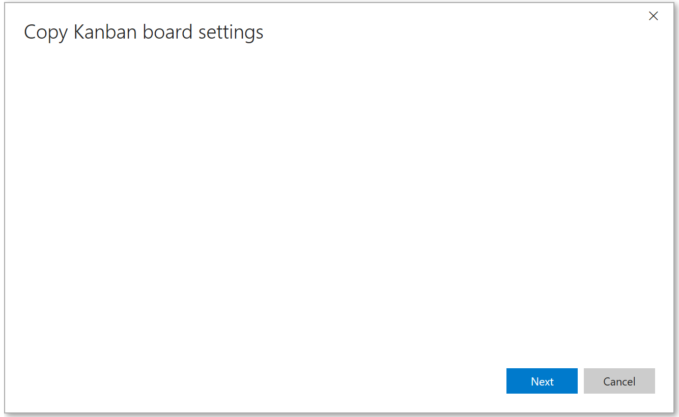
| Apply board configuration
Copy board settings from another team Will allow you to select another team from the same team project and apply the settings from their Kanban board to yours.
Copy board settings to other team(s) Will allow you to select another team(s) from the same team project and apply your Kanban board settings to theirs.

Slide 9

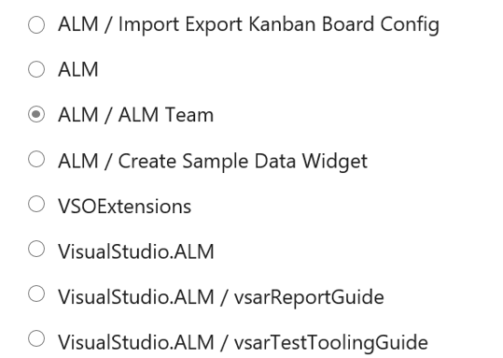

| Apply board configuration

Slide 10


| Apply board configuration
Please confirm that you wish to copy the settings from ALM to ALM / ALM TEAM.
All existing data on destination team will be overwritten.
The following board settings will be copied
Cards
Board
General
Copy Settings

Slide 11

| Applying board configuration

Slide 12
As a project administrator I want to copy a team settings to one or more teams

Slide 13
| Apply board configuration
Copy board settings from another team Will allow you to select another team from the same team project and apply the settings from their Kanban board to yours.
Copy board settings to other team(s) Will allow you to select another team(s) from the same team project and apply your Kanban board settings to theirs.

Slide 14
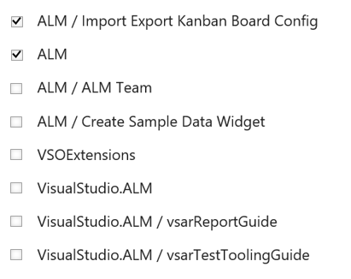
| Apply board configuration
A filterable list of teams may work for smaller accounts, but may need something more advanced for accounts with many teams (seen examples of 200+ teams)
2 Selected project(s)

Slide 15

| Apply board configuration
Please confirm that you wish to copy the settings from VSOExtensions to ALM / Import Export Kanban Board Config ; ALM
All existing data on destination team(s) will be overwritten.
The following board settings will be copied
Cards
Board
General
Copy Settings

Slide 16
| Applying board configuration

Slide 17
As a project administrator I want to export board settings to a file for backup, later restore or import into another team

Slide 18
Apply to other team(s)
Apply from other team
Export configuration
Import configuration

Slide 19
| Apply board configuration
Copy board settings from another team Will allow you to select another team from the same team project and apply the settings from their Kanban board to yours.
Copy board settings to other team(s) Will allow you to select another team(s) from the same team project and apply your Kanban board settings to theirs.
Import board settings from JSON Will allow you to import the board configuration as a JSON file which was exported from another team or recover an old version.
Export board configuration to JSON Will allow you to export the board configuration as a JSON file which will allow you to import it to another team or recover an old version.

Slide 20

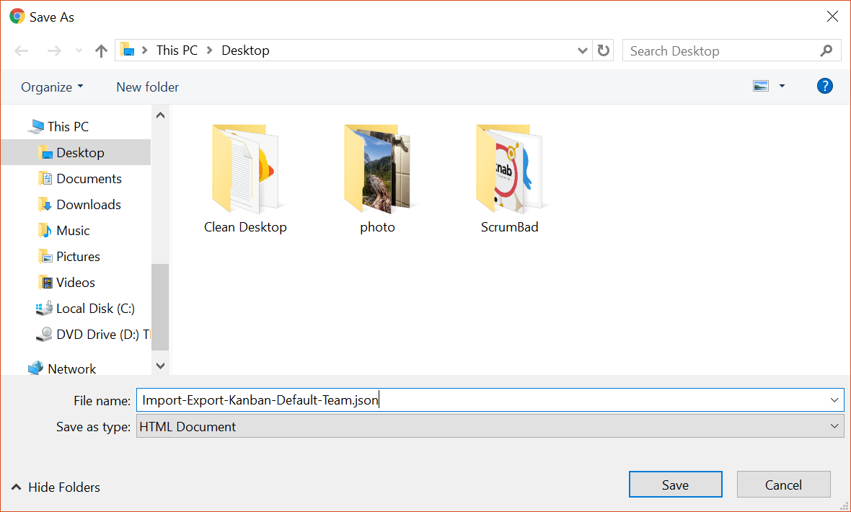

| Apply board configuration
The following board settings will included in the file
Cards
Board
General

Slide 21
As a project administrator I want to import board settings from a file to restore previous settings or import from another team

Slide 22
| Apply board configuration
Copy board settings from another team Will allow you to select another team from the same team project and apply the settings from their Kanban board to yours.
Copy board settings to other team(s) Will allow you to select another team(s) from the same team project and apply your Kanban board settings to theirs.
Import board settings from JSON Will allow you to import the board configuration as a JSON file which was exported from another team or recover an old version.
Export board configuration to JSON Will allow you to export the board configuration as a JSON file which will allow you to import it to another team or recover an old version.

Slide 23


| Apply board configuration
Upload JSON file with settings

Slide 24
| Apply board configuration
2 Selected project(s)

Slide 25
| Apply board configuration
Please confirm that you wish to copy the settings from team settings.json
to ALM / Import Export Kanban Board Config ; ALM
All existing data on destination team(s) will be overwritten.
The following board settings will be copied
Cards
Board
General
Copy Settings

Slide 26
| Apply board configuration

Slide 27
As a project administrator I want to import only specific board settings when importing from another team or file.

Slide 28
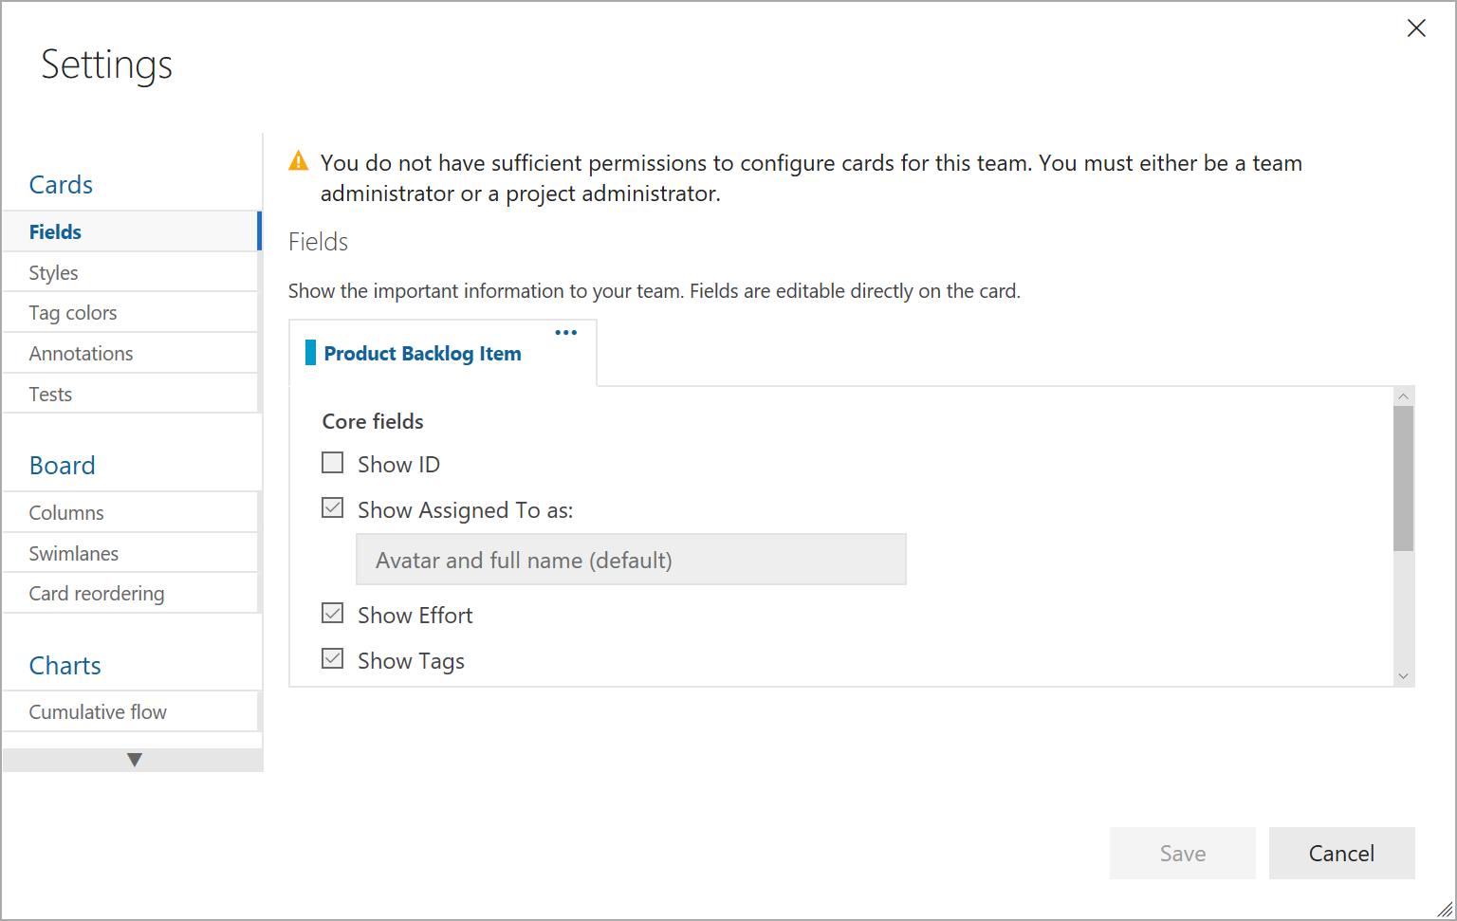

| Apply board configuration
| Advanced Import / Export
Epic
Feature
Product backlog Item
Bug
text
Next

Slide 29
Additional discoverability

Slide 30
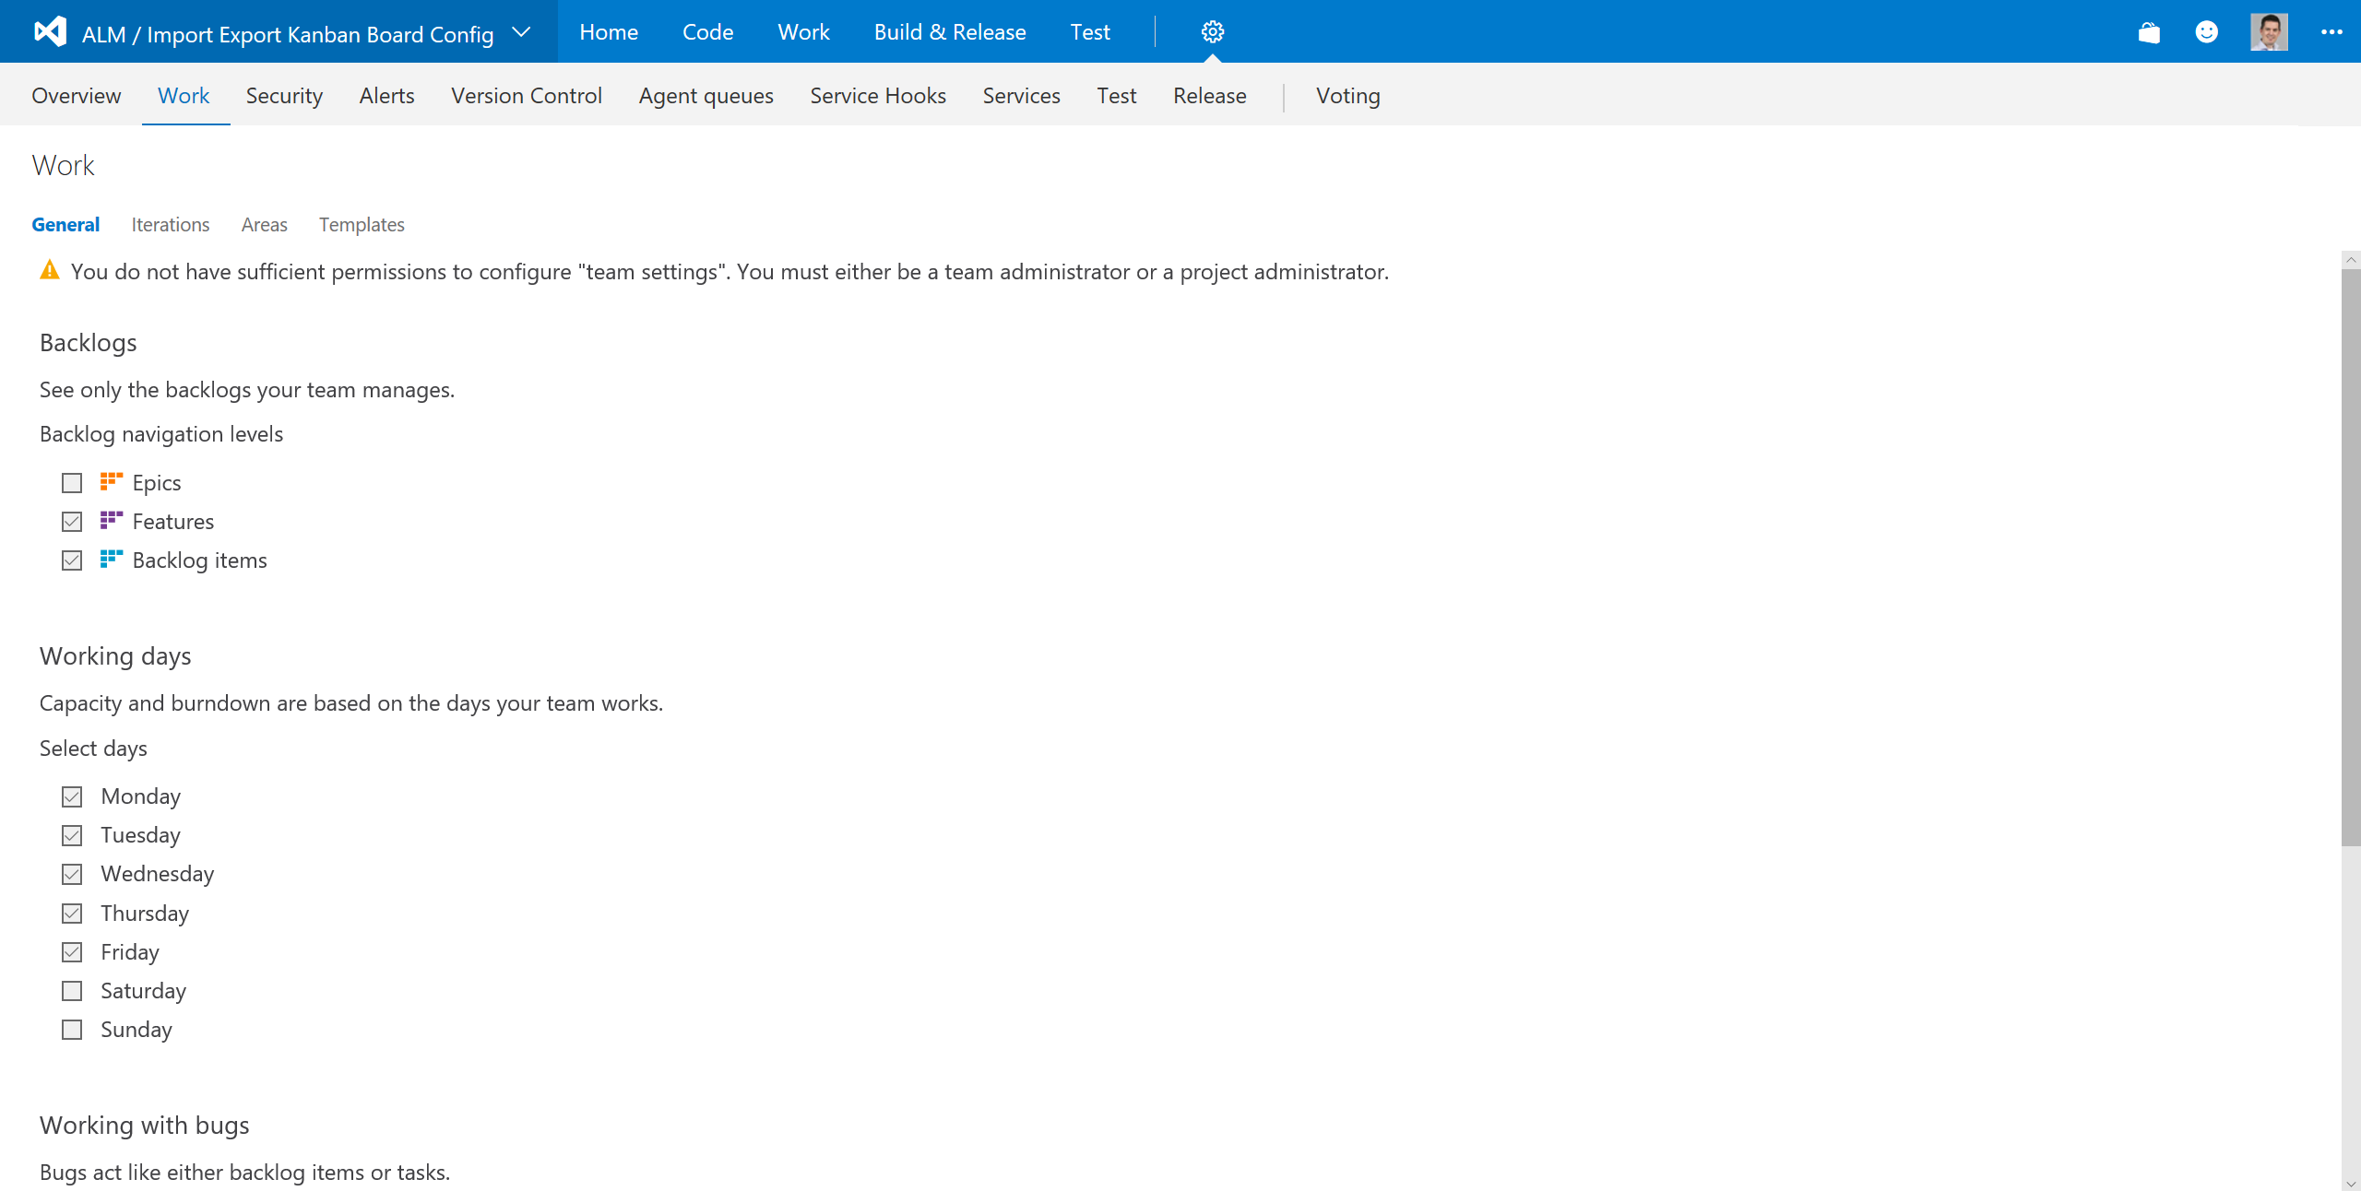
If it is possible to extend the items shown on the General page, it could also offer a logical starting point for the extension
Import / Export configuration
Apply your team configuration to another team or apply the configuration of another team to yours.
Start

Slide 31

board layout
Want to share your board layout with another team? Or does the team next door have a much nicer layout than you?
Start sharing your configuration with others
Start
Or provide an additional tab just to launch the wizard.

Slide 32
| Apply board configuration
Copy board settings from another team Will allow you to select another team from the same team project and apply the settings from their Kanban board to yours.
Copy board settings to other team(s) Will allow you to select another team(s) from the same team project and apply your Kanban board settings to theirs.
Import board settings from JSON Will allow you to import the board configuration as a JSON file which was exported from another team or recover an old version.
Export board configuration to JSON Will allow you to export the board configuration as a JSON file which will allow you to import it to another team or recover an old version.

Slide 33
Roadmap
Version One
Backlog
Scoped to team project
Export settings to multiple teams at once
Import settings from other team
Kanban board settings are overwritten, not merged
Nice to have
Selection of components to copy
Eg: Cards, Board, Charts, General
Reset
Clear all values and set them to the OOTB values

Slide 34
Roadmap
Version Two
Backlog
Still Scoped to team project
Import/export to JSON file
Nice to have
Finer grained selection of components to copy/import
Cards (fields,styles,tag colors)
Board (columns,swimlanes)
Charts
General

Slide 35
Roadmap
V3
Add support for task board

Slide 36
Roadmap
Version Four
Remove team scope limitation.
Import JSON file to any team project
Implement validations

Slide 37
Roadmap
Version Five
Backlog
Named configurations
Save configurations
Overwrite/Merge option
Nice to have
Finer grained selection of components to import
Cards (fields, styles)
Board
General (backlogs,working days, working with bugs)

Slide 38
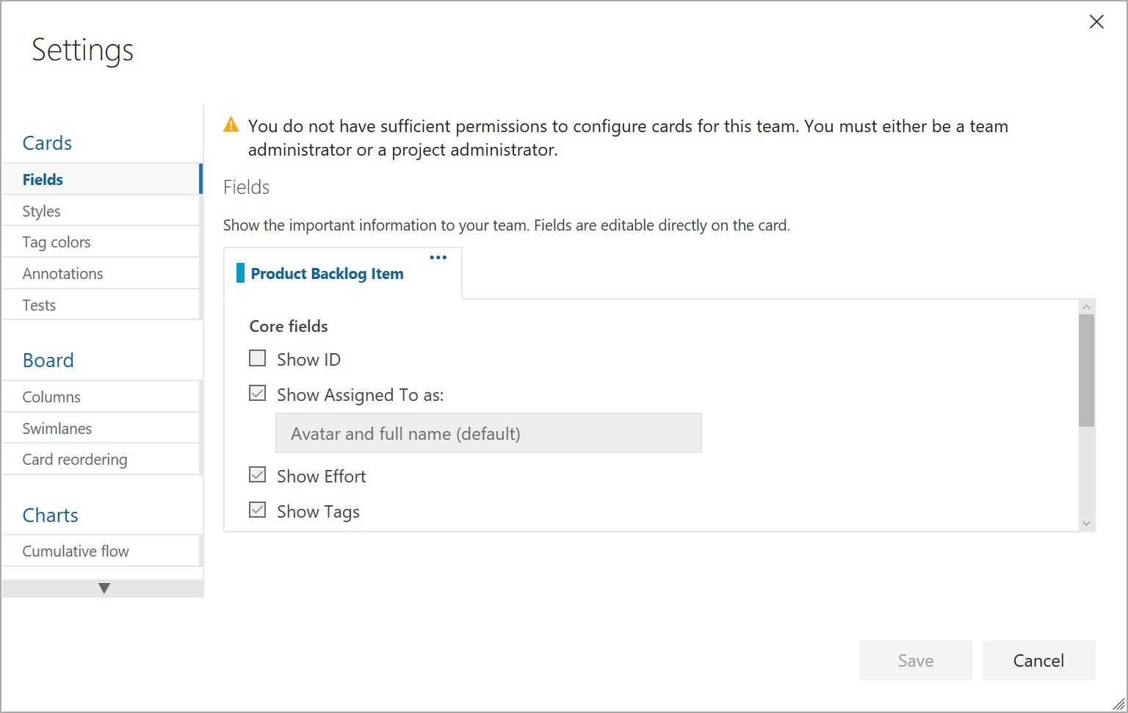
| Apply board configuration
Apply board configuration from another team Will allow you to select another team from the same team project and apply the team configuration from their Kanban board and Work settings to yours.
Apply board configuration to other team(s) Will allow you to select another team(s) from the same team project and apply the team configuration from your Kanban board and Work settings to theirs.
Import board configuration from JSON Will allow you to export the board configuration as a JSON file which will allow you to import it to another team on another Team Project / Account / Server.
Export board configuration to JSON Will allow you to import the board configuration from a JSON file with the configuration from another Team Project / Account / Server.
Next

Slide 39
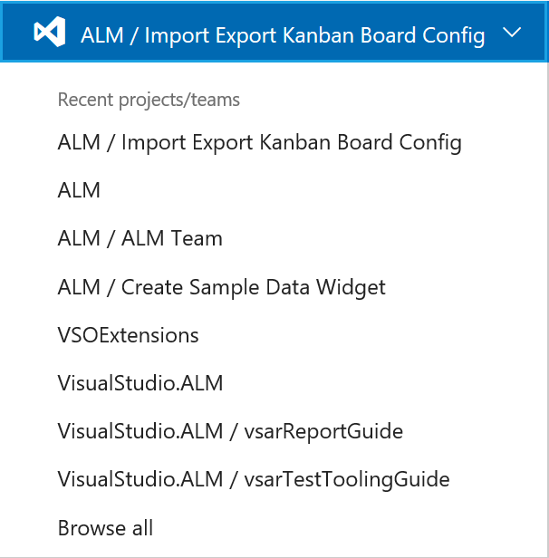
| Apply board configuration from another team
Next

Slide 40
| Apply board configuration to other team(s)
Next

Slide 41
| Import board configuration from JSON
Browse
Next

Slide 42

| Ready
Ready to [Import | Apply from | Apply To] Team project A – Team A
This will reset these team(s)’ boards and apply the configuration from Team Project D – Team B. Any customizations currently applies in these teams will be lost.
Confirm

Slide 43
| Export board configuration to JSON
Click download to save this Team’s board configuration to a JSON file, which can be imported to another team project.
Note: if the board configuration relies on specific customizations (fields, area path structure etc), these will not be exported as part of the configuration. Importing the configuration may fail because of that.
Download

Slide 44
| Advanced Import / Export
Epic
Feature
Product backlog Item
Bug
text
Next

Slide 45
| Applying Configuration

Slide 47
| Apply board configuration
Apply board configuration from another team Will allow you to select another team from the same team project and apply the team configuration from their Kanban board and Work settings to yours.
Apply board configuration to other team(s) Will allow you to select another team(s) from the same team project and apply the team configuration from your Kanban board and Work settings to theirs.
Import board configuration from JSON Will allow you to export the board configuration as a JSON file which will allow you to import it to another team on another Team Project / Account / Server.
Export board configuration to JSON Will allow you to import the board configuration from a JSON file with the configuration from another Team Project / Account / Server.
Next

Slide 48
| Apply board configuration from another team
Next

Slide 49
| Apply board configuration to other team(s)
Next

Slide 50
| Import board configuration from JSON
Browse
Next

Slide 51
| Ready
Ready to [Import | Apply from | Apply To] Team project A – Team A
This will reset these team(s)’ boards and apply the configuration from Team Project D – Team B. Any customizations currently applies in these teams will be lost.
Confirm

Slide 52
| Export board configuration to JSON
Click download to save this Team’s board configuration to a JSON file, which can be imported to another team project.
Note: if the board configuration relies on specific customizations (fields, area path structure etc), these will not be exported as part of the configuration. Importing the configuration may fail because of that.
Download

Slide 53
| Advanced Import / Export
Epic
Feature
Product backlog Item
Bug
text
Next

Slide 54
| Applying Configuration

